Slide 1
Digital Signal Processing(BEC-303)
Unit-1
Lecture-4
Presented By:
Dr. Ishwar Chandra Yadav

Slide 2
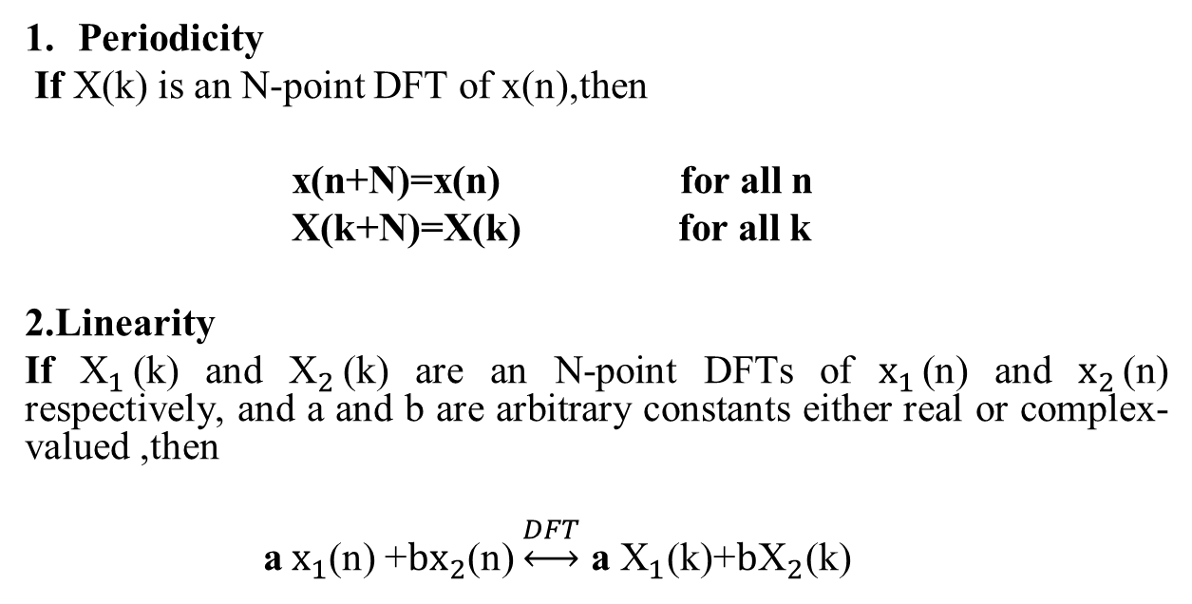
Properties of the DFT
Periodicity
If X(k) is an N-point DFT of x(n),then
x(n+N)=x(n) for all n
X(k+N)=X(k) for all k
2.Linearity
If ${\text{X}}_{1}$(k) and ${\text{X}}_{2}$(k) are an N-point DFTs of ${\text{x}}_{1}$(n) and ${\text{x}}_{2}$(n) respectively, and a and b are arbitrary constants either real or complex-valued ,then
a ${\text{x}}_{1}$(n) +${\text{b}\text{x}}_{2}$(n) $\underset{↔}{DFT}$ a ${\text{X}}_{1}$(k)+${\text{b}\text{X}}_{2}$(k)

Slide 3
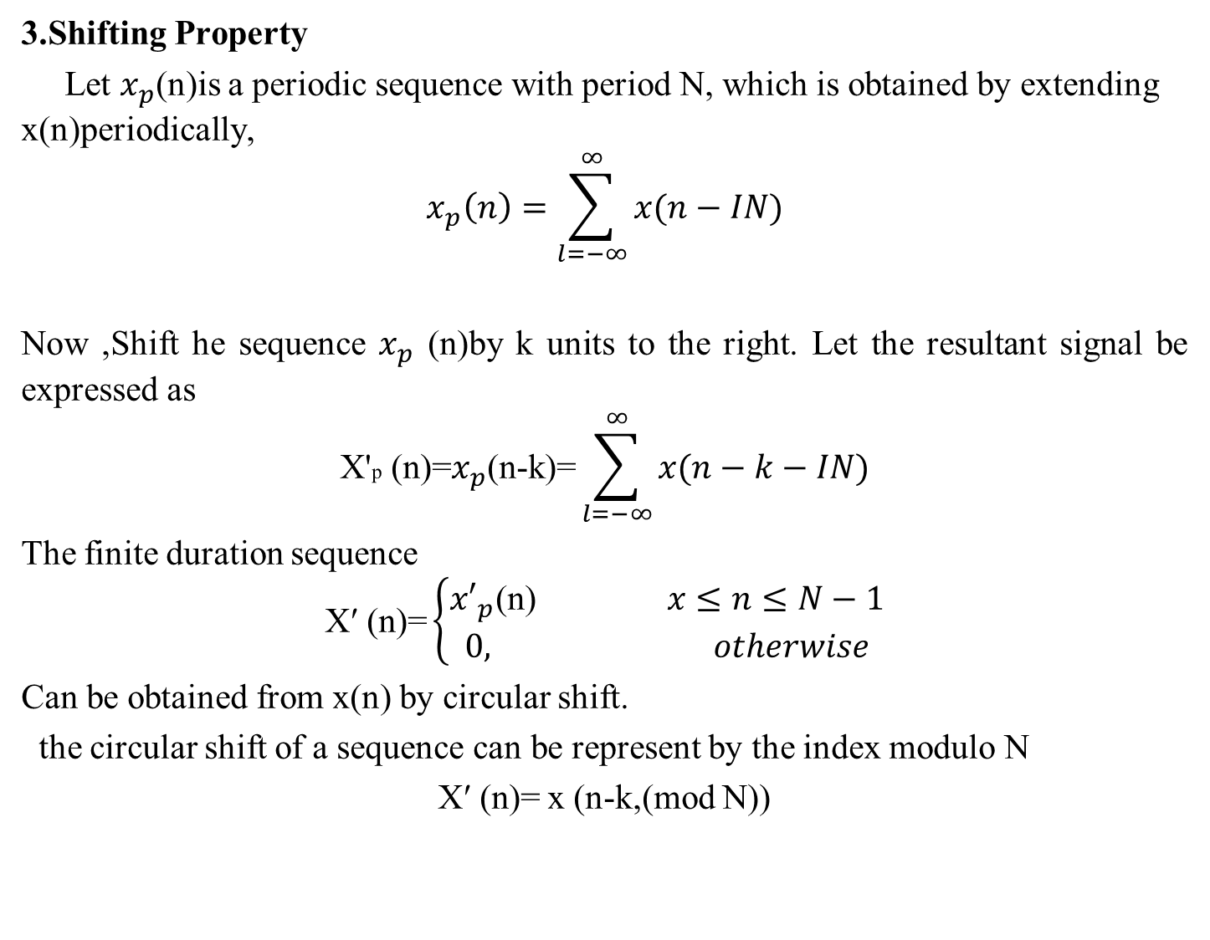
3.Shifting Property
Let $x_{p}$(n)is a periodic sequence with period N, which is obtained by extending x(n)periodically,
$$x_{p}\left(n\right)=\sum_{l=−∞}^{∞}{x(n−IN)}$$
Now ,Shift he sequence $x_{p}$ (n)by k units to the right. Let the resultant signal be expressed as
$$\text{X}\text{′}\text{p}\text{ (}\text{n}\text{)=}x_{p}\text{(}\text{n}\text{−}\text{k}\text{)=}\sum_{l=−∞}^{∞}{x(n−k−IN)}$$
The finite duration sequence
$$\text{X}\text{′}\text{ (}\text{n}\text{)=}\left\{\begin{aligned}{x′}_{p}\text{(}\text{n}\text{) }x≤n≤N−1 \\ 0, otherwise\end{aligned}\right.$$
Can be obtained from x(n) by circular shift.
the circular shift of a sequence can be represent by the index modulo N
$\text{X}\text{′}\text{ (}\text{n}\text{)=}$x (n-k,(mod N))

Slide 4
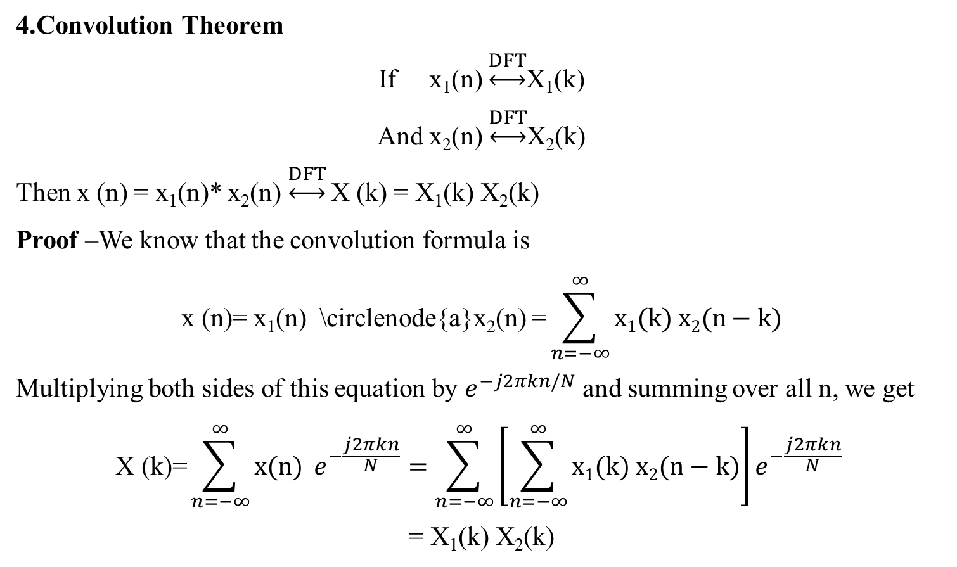
\circlenode{A}{a}
\circlenode{A}{a}
4.Convolution Theorem
If x₁(n) $\underset{↔}{DFT}$X₁(k)
And x₂(n) $\underset{↔}{DFT}$X₂(k)
Then x (n) = x₁(n)* x₂(n)$\underset{↔}{DFT}$ X (k) = X₁(k) X₂(k)
Proof –We know that the convolution formula is
$$\text{x}\text{ (}\text{n}\text{)= }\text{x}\text{1}\text{(}\text{n}\text{)} \text{\backslash }\text{circlenode}\text{\{}\text{a}\text{\}}\text{x}\text{2}\text{(}\text{n}\text{)} \text{=}\sum_{n=−∞}^{∞}{x1(k) x2(n−k)}$$
Multiplying both sides of this equation by $e^{−j2πkn/N}$ and summing over all n, we get
$$\text{X}\text{ (}\text{k}\text{)=}\sum_{n=−∞}^{∞}{x(n) }e^{−\frac{j2πkn}{N}}=\sum_{n=−∞}^{∞}{\left[\sum_{n=−∞}^{∞}{x1(k) x2(n−k)}\right]e^{−\frac{j2πkn}{N}} }$$
= X₁(k) X₂(k)
Hence, if two signals are converted in the time domain, then it is equivalent to multiplying their spectra in the frequency domain.

Slide 5
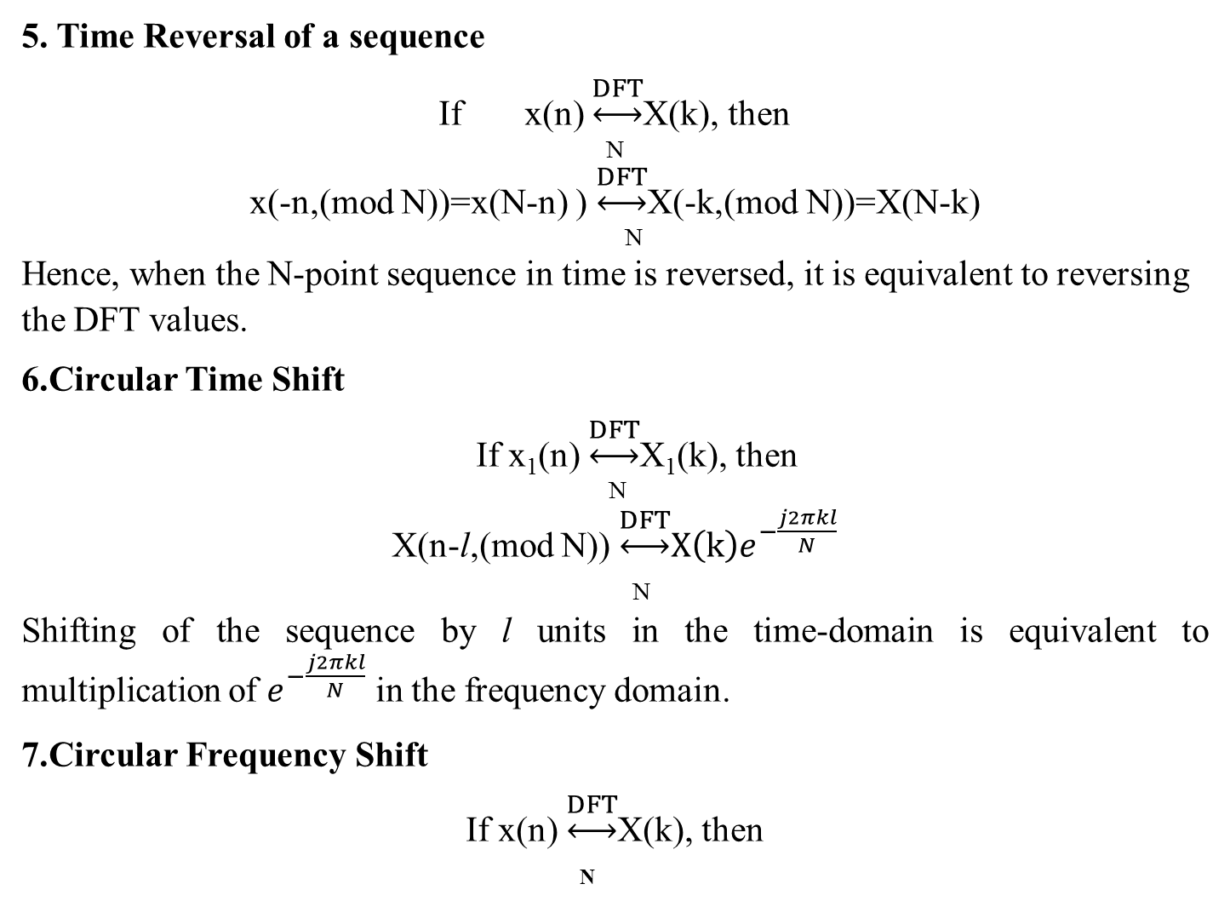
5. Time Reversal of a sequence
If x(n) $\underset{↔}{DFT}$X(k), then
N
x(-n,(mod N))=x(N-n) ) $\underset{↔}{DFT}$X(-k,(mod N))=X(N-k)
N
Hence, when the N-point sequence in time is reversed, it is equivalent to reversing the DFT values.
6.Circular Time Shift
If x₁(n) $\underset{↔}{DFT}$X₁(k), then
N
X(n-l,(mod N)) $\underset{↔}{DFT}{X\left(k\right)e}^{−\frac{j2πkl}{N}}$
N
Shifting of the sequence by l units in the time-domain is equivalent to multiplication of $e^{−\frac{j2πkl}{N}}$ in the frequency domain.
7.Circular Frequency Shift
If x(n) $\underset{↔}{DFT}$X(k), then
N

Slide 6
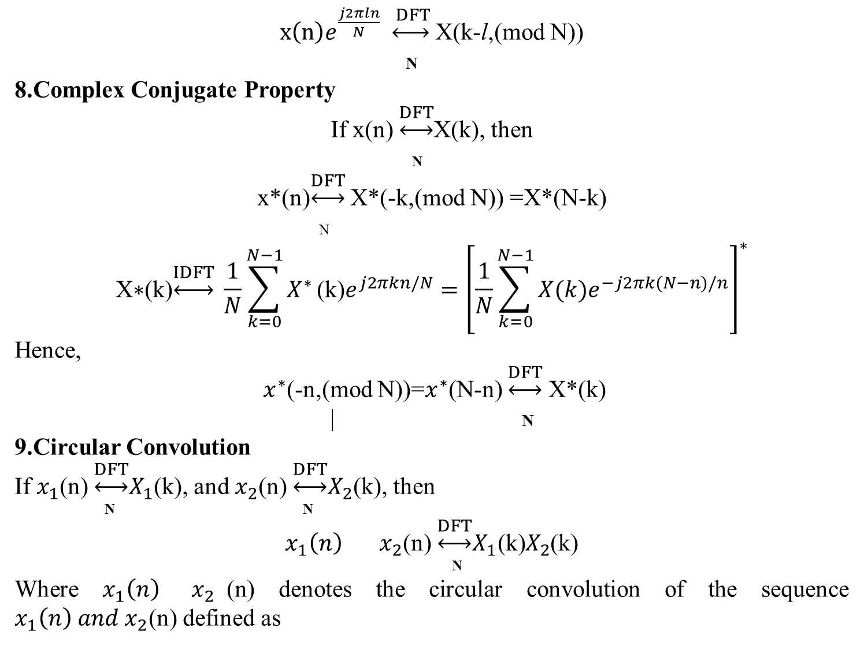
${x\left(n\right)e}^{\frac{j2πln}{N}} \underset{↔}{ DFT}$ X(k-l,(mod N))
N
8.Complex Conjugate Property
If x(n) $\underset{↔}{DFT}$X(k), then
N
x*(n)$\underset{↔}{DFT}$ X*(-k,(mod N)) =X*(N-k)
N
$$\text{X}\text{∗(}\text{k}\text{)}\underset{↔}{IDFT} \frac{1}{N}\sum_{k=0}^{N−1}{X^{∗}}\text{(}\text{k}\text{)}e^{j2πkn/N}={\left[\frac{1}{N}\sum_{k=0}^{N−1}{X(k)e^{−j2πk(N−n)/n}}\right]}^{∗}$$
Hence,
${ x}^{∗}$(-n,(mod N))=$x^{∗}$(N-n) $\underset{↔}{DFT}$ X*(k)
| N
9.Circular Convolution
If $x_{1}$(n) $\underset{↔}{DFT}X_{1}$(k), and $x_{2}$(n) $\underset{↔}{DFT}X_{2}$(k), then
N N
$x_{1}\left(n\right) x_{2}$(n) $\underset{↔}{DFT}{X_{1}\text{(}\text{k}\text{)}X}_{2}$(k)
N
Where $x_{1}\left(n\right) { x}_{2}$(n) denotes the circular convolution of the sequence $x_{1}\left(n\right) and x_{2}$(n) defined as
N
N

Slide 7
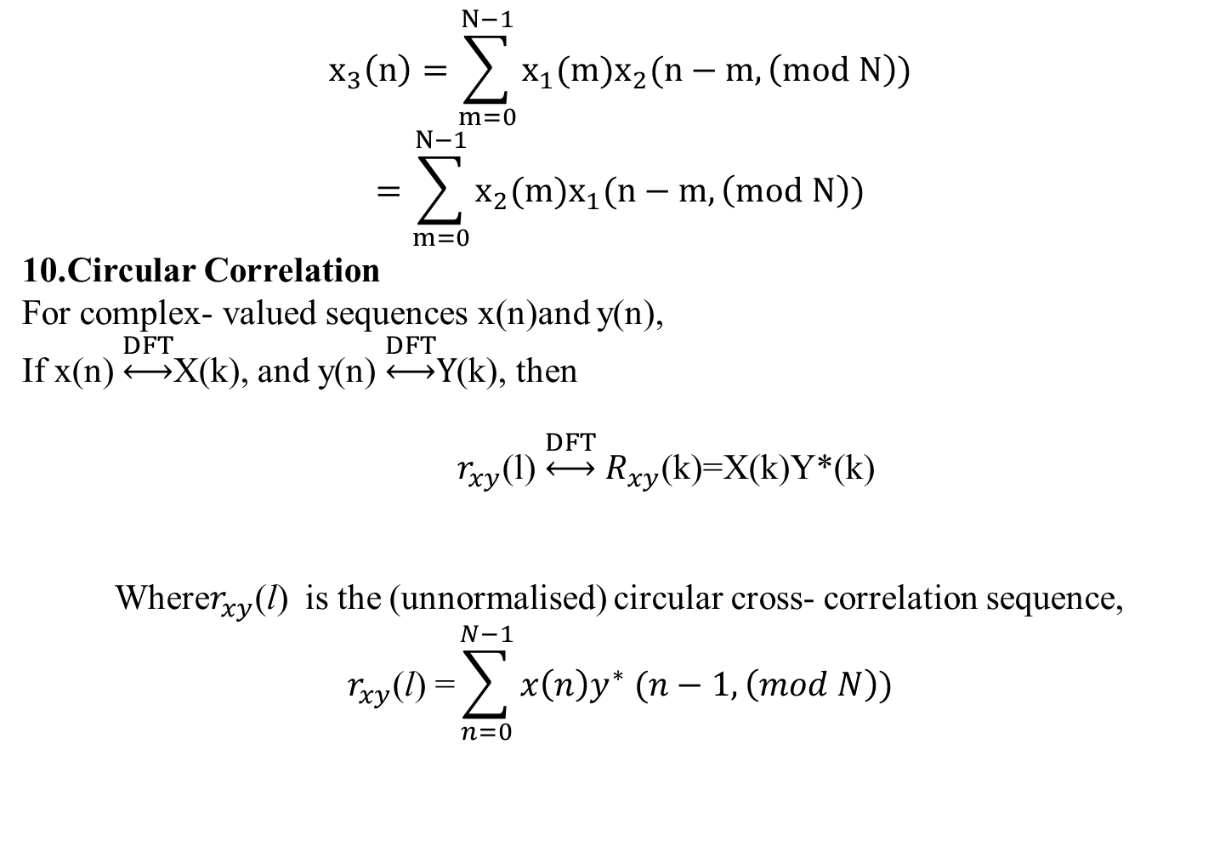
$$x_{3}\left(n\right)=\sum_{m=0}^{N−1}{x_{1}(m)x_{2}(n−m,\left(mod N\right))}$$
$$=\sum_{m=0}^{N−1}{x_{2}(m)x_{1}(n−m,\left(mod N\right))}$$
10.Circular Correlation
For complex- valued sequences x(n)and y(n),
If x(n) $\underset{↔}{DFT}$X(k), and y(n) $\underset{↔}{DFT}Y$(k), then
$r_{xy}$(l) $\underset{↔}{DFT}$ $R_{xy}$(k)=X(k)Y*(k)
Where$r_{xy}$(l) is the (unnormalised) circular cross- correlation sequence,
$$r_{xy}\text{(}\text{l}\text{)}\text{ =}\sum_{n=0}^{N−1}{x\left(n\right)y^{∗} (n−1,\left(mod N\right))}$$
N
N
N

Slide 8
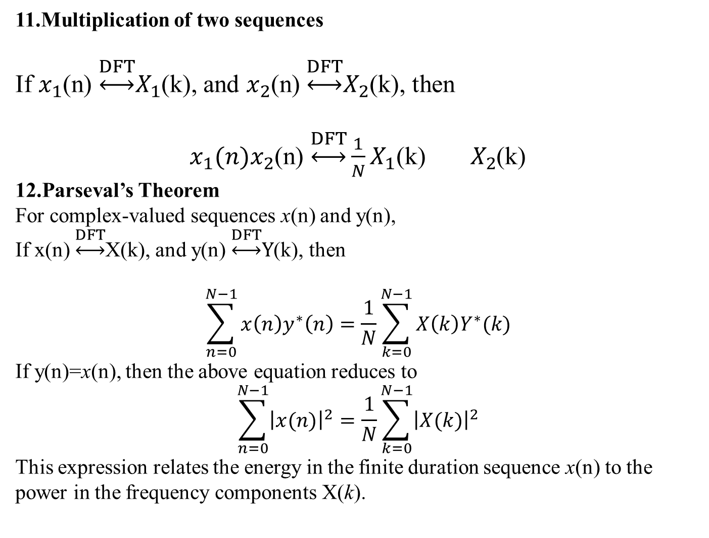
11.Multiplication of two sequences
If $x_{1}$(n) $\underset{↔}{DFT}X_{1}$(k), and $x_{2}$(n) $\underset{↔}{DFT}X_{2}$(k), then
$x_{1}(n)x_{2}$(n) $\underset{↔}{DFT}{\frac{1}{N}X_{1}\text{(}\text{k}\text{)} X}_{2}$(k)
12.Parseval’s Theorem
For complex-valued sequences x(n) and y(n),
If x(n) $\underset{↔}{DFT}$X(k), and y(n) $\underset{↔}{DFT}Y$(k), then
$$\sum_{n=0}^{N−1}{x\left(n\right)y^{∗}\left(n\right)=\frac{1}{N}}\sum_{k=0}^{N−1}{X\left(k\right)Y^{∗}(k)}$$
If y(n)=x(n), then the above equation reduces to
$$\sum_{n=0}^{N−1}{{\left|x(n)\right|}^{2}=\frac{1}{N}}\sum_{k=0}^{N−1}{{\left|X(k)\right|}^{2}}$$
This expression relates the energy in the finite duration sequence x(n) to the power in the frequency components X(k).
N
N
N
N
N
N

